Slide 1
Single Page Applications
Mendel Rosenblum

Slide 2
Web Apps and Browsers
Web apps run in browsers (by definition)
Users are use to browsing in browsers
  Browser maintains a history of URLs visited
    Back button - Go back in history to previous URL
    Forward button - Go forward in history to next URL
  Can move to a different page
    Typing into location bar or forward/back buttons
    Selecting a bookmarked URL
    Page refresh operation
Browser tosses the current JavaScript environment when navigating to a different page
  Problematic for JavaScript frameworks: URL (and cookies) are the only information preserved

Slide 3
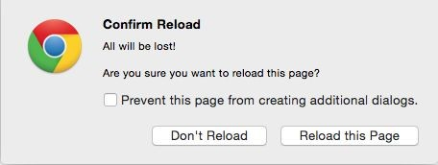
Problem with some web apps
Initial: pages served from web server
  Each page had a URL and app switched between pages served by web server
Early JavaScript apps: Website a single page/URL with the JavaScript Problem: Restart web app on navigation (Can lose a lot of work!)
window.onbeforeunload = function(e) { return 'All will be lost!'; }
Users expect app in browser to do the right thing:
  Navigate with forward and back buttons, browser page history
  Navigate away and come back to the app
  Bookmark a place in the app
  Copy the URL from the location bar and share it with someone
  Push the page refresh button on the browser

Slide 4
Changing URL without page refresh
Can change hash fragment in URL without reload
http://example.com http://example.com#fragment http://example.com?id=3535 http://example.com?id=3535#fragment
HTML5 give JavaScript control of page reload
  Browser History API - window.history - Change URL without reloading page

Slide 5
Deep linking
Concept: the URL should capture the web app's context so that directing the browser to the URL will result the app's execution to that context
  Bookmarks
  Sharing
Context is defined by the user interface designer!
Consider: Viewing information of entity and have an edit dialog open
Should the link point to the entity view or to the entity & dialog? Does it matter if I'm bookmarking for self or sharing with others?
How about navigating away and back or browser refresh?

Slide 6
Deep linking in Single Page Apps
Two approaches:
Maintain the app's context state in the URL
+ Works for browser navigation and refresh
+ User can copy URL from location bar
Provide a share button to generate deep linking URL
+ Allows user to explicitly fetch a URL based on need
+ Can keep URL in location bar pretty
Either way web app needs to be able to initialize self from deep linked URL

Slide 7
Ugly URLs
http://www.example.org/dirmod?sid=789AB8&type=gen&mod=Core+Pag es&gid=A6CD4967199
versus
http://www.example.org/show/A6CD4967199
What is that ugly thing in the location bar above my beautiful web application?
https://www.flickr.com/photos/jarnasen/24593000826/in/explore-2016-01-26/
Notes:
Not clean and readable URL!

Slide 8
ReactJS support for SPA
ReactJS has no opinion! Need 3rd party module.
Example: React Router https://reacttraining.com/react-router/
  Idea: Use URL to control conditional rendering
Various ways of encoding information in URL
  In fragment part of the URL: HashRouter
  Use HTML5 URL handler: BrowserRouter
Import as a module:
import {HashRouter, Route, Link, Redirect} from 'react-router-dom';
Notes:
BrowserRouter - uses history API, (pushState, replaceState and the popstate event) to keep your UI in sync with the URL.
HashRouter - uses URL hash, it puts no limitations on supported browsers or web server.
Server-side routing is independent from client-side routing.

Slide 9
Example React Router
<HashRouter>
<div>
...
<Route path="/states" component={States} />
...
<Link to="/states">States</Link>
...
</div>
</HashRouter>
JSX block controlled by URL enclosed in HashRouter
Route will render the component if URL matches.
Use Link component to generated hyperlink:
<a href="#/states"> States
</a>
CS142 Lecture Notes - Single Page Apps

Slide 10

Passing parameters with React Router
Parameter passing in URL
<Route
path="/Book/:book/ch/:chapter" component={BookChapterComponent}
/>
Parameters put in prop.match of the component function BookChapterComponent({ match }) {
return ( <div>
<h3>Book: {match.params.book}</h3>
<Link to="/Book/Moby/ch/1"> Moby
</Link>
<h3>Chapter: {match.params.chapter}</h3>
</div> );
}

Slide 11
Route: component=, render=, children=
component={BookChapterComponent}
  Mounts components on match (unmounts on URL change)
  Passes match object with: params, url, history
render={props => <BookChapterComponent book={props.match.params.book}
chapter={props.match.params.chapter} />}
  Calls function with props having match object from above.
  Doesn't mount/unmount component (does update it)
children= - Like render= except is called regardless of the match
  match will be null if URL doesn't match
  Useful if you want to have something always render but only active on matching URL.
Multiple route matches have precedence order: component, render, children
Switch is useful with multiple Route - Renders the first matching one
Notes:
3 ways to render:
<Route component> - mostly used, always create a new React element
<Route render> - inline rendering without remounting
<Route children> - render whether the path matches the location or not.

Slide 12
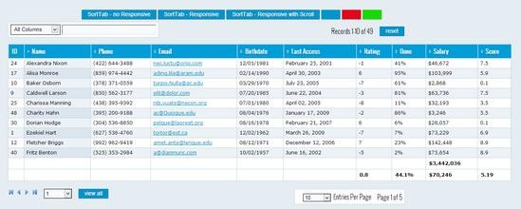
Example
What to keep in URL: table length, viewport in table, search box, sort column, etc. Is it different for bookmark or share? Nav away and back?

Slide 13
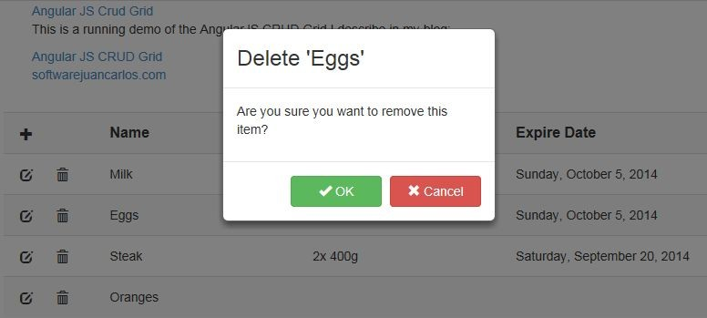
Example: Not everything goes in URL

